Slide 1
PROJECT PRESENTATION CAR PRICE PROJECT
Notes:
This template can be used as a starter file to give updates for project milestones.
Sections
Right-click on a slide to add sections. Sections can help to organize your slides or facilitate collaboration between multiple authors.
Notes
Use the Notes section for delivery notes or to provide additional details for the audience. View these notes in Presentation View during your presentation.
Keep in mind the font size (important for accessibility, visibility, videotaping, and online production)
Coordinated colors
Pay particular attention to the graphs, charts, and text boxes.
Consider that attendees will print in black and white or grayscale. Run a test print to make sure your colors work when printed in pure black and white and grayscale.
Graphics, tables, and graphs
Keep it simple: If possible, use consistent, non-distracting styles and colors.
Label all graphs and tables.

Slide 2
Project Overview
What is the project about?
Define the goal of this project
Data Collection
Notes:
What is the project about?
Define the goal of this project
Is it similar to projects in the past or is it a new effort?
Define the scope of this project
Is it an independent project or is it related to other projects?
* Note that this slide is not necessary for weekly status meetings

Slide 3
What is the project about?
The problem of predicting used car prices involves the use of algorithms and statistical models to predict the value of a used car based on a set of features. The features may include the make and model of the car, its age, mileage, condition, and other relevant information.
The goal of this problem is to build a model that can accurately estimate the value of a used car, so that buyers and sellers can make informed decisions about the price of a car. To do this, machine learning algorithms are trained on large datasets of used car prices, using the features of each car as input and the corresponding price as output.
This problem is challenging because used car prices can be influenced by a wide range of factors, such as market conditions, local economic conditions, and the specific features and condition of the car. Therefore, a good model must be able to capture the complex relationships between these factors and used car prices.
The use of machine learning for this problem is attractive because it allows for the automation of the prediction process, and can also provide insights into the relative importance of different features for used car pricing. This can be useful for both buyers and sellers, as well as for car dealerships, who can use these insights to optimize their pricing strategies.

Slide 4
GOAL
With the covid 19 impact in the market, we have seen lot of changes in the car market. Now some cars are in demand hence making them costly and some are not in demand hence cheaper. One of our clients works with small traders, who sell used cars. With the change in market due to covid 19 impact, our client is facing problems with their previous car price valuation machine learning models. So, they are looking for new machine learning models from new data. We have to make car price valuation model.

Slide 5
DATA COLLECTION
I have scraped at least 5000 used cars data. In this section I have scraped the data of used cars from websites Quikr classified for used products in India . I have fetch data for different locations.. Generally, these columns are Brand, model, variant, manufacturing year, driven kilometers, fuel, number of owners, location and at last target variable Price of the car. This data is to give me a hint about important variables in used car model. I have included all types of cars in your data for example- SUV, Sedans, Coupe, minivan, Hatchback.
In total I have accumulated 8794 car ads with 6 variables

Slide 6
Shape of DATA
Column Non-Null Count Dtype
--- ------ -------------- -----
0 name 8794 non-null object
1 company 8794 non-null object
2 year 8794 non-null object
3 Price 8794 non-null object
4 kms_driven 8740 non-null object
5 fuel_type 8741 non-null object

Slide 7
DATA CLEANING
The Steps followed in order to clean the data
names are pretty inconsistent
names have company names attached to it
some names are spam like 'Maruti Ertiga showroom condition with' and 'Well mentained Tata Sumo'
company: many of the names are not of any company like 'Used', 'URJENT', and so on.
year has many non-year values
year is in object. Change to integer
Price has Ask for Price
Price has commas in its prices and is in object
kms_driven has object values with kms at last.
It has nan values and two rows have 'Petrol' in them
fuel_type has nan values
name and company had spammed data...but with the previous cleaning, those rows got removed
Resetting the index of the final cleaned data
Removing the duplicate data
Only considering price of cars till 60-70 lakhs as it is illogical to sell higher price car in quikr and can be sold in showroom itself.
Converting the categorical columns to numerical using one hot encoder
Finally we end up with 8718 rows loss of less than 2-3% of data

Slide 8
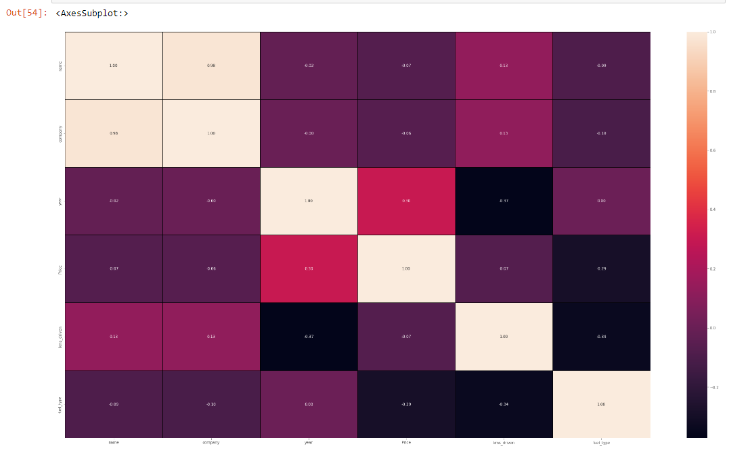
Correlation

Slide 9
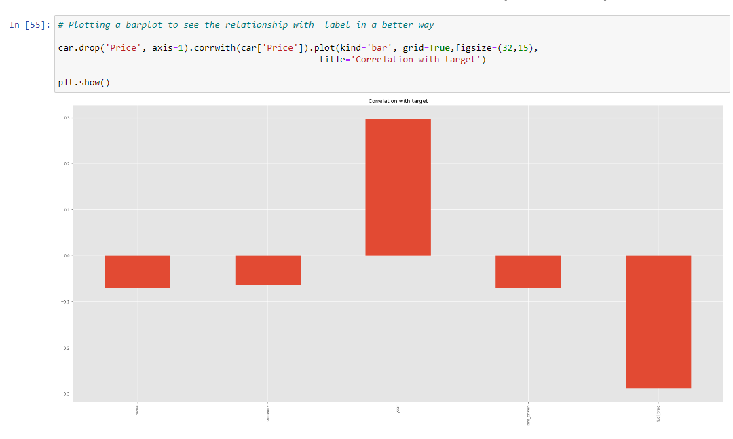
Top more correlated with Target

Slide 10
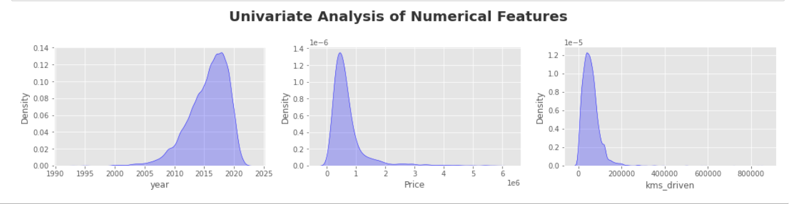
Visualization - EDA

Slide 11
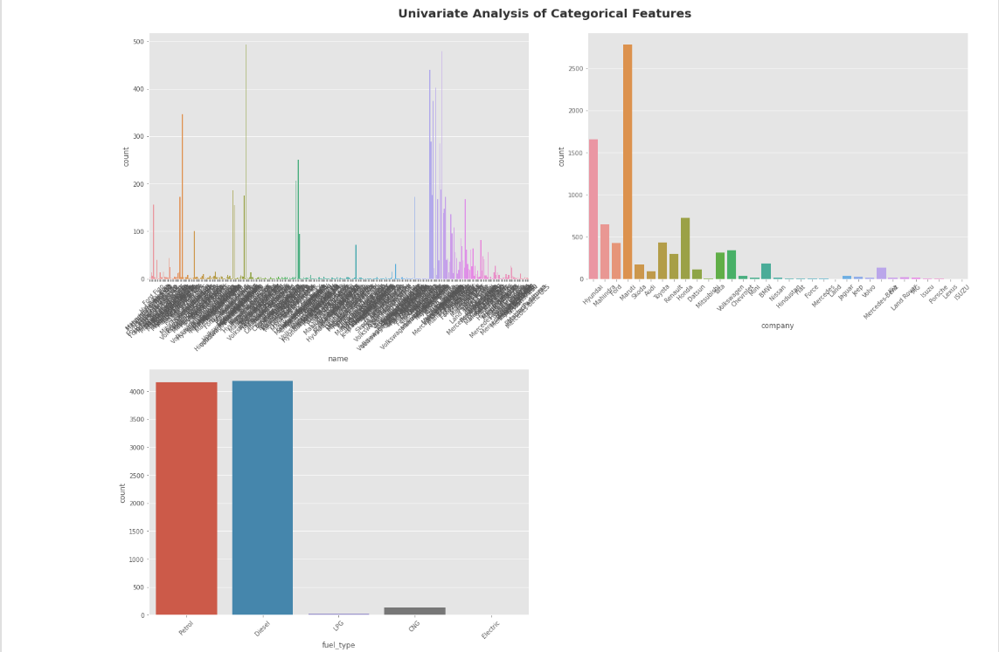

Slide 12
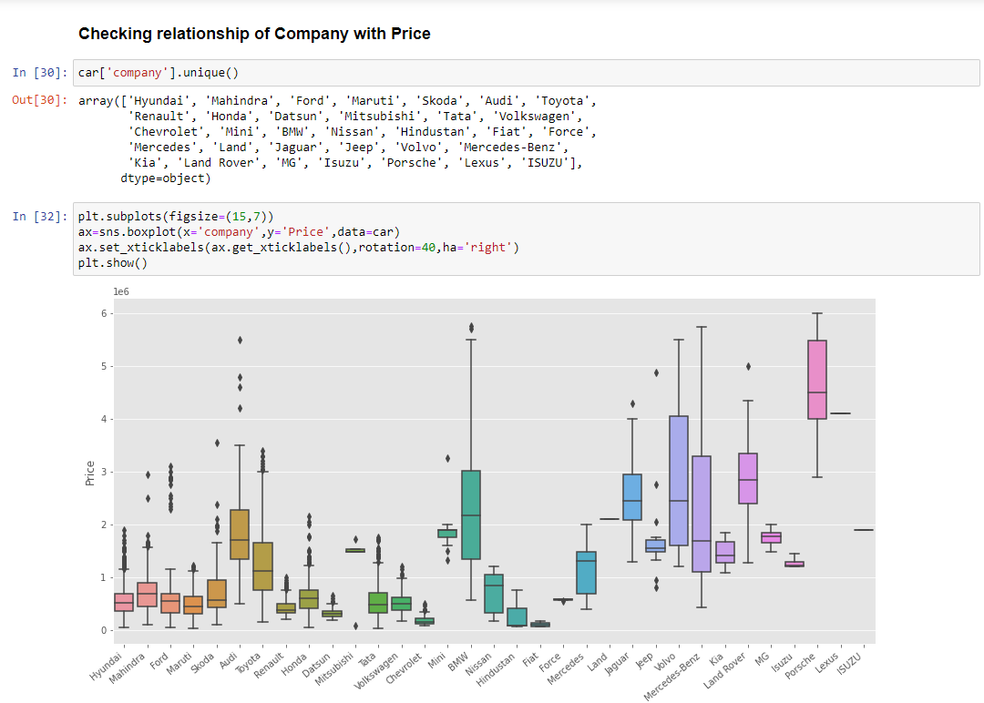

Slide 13
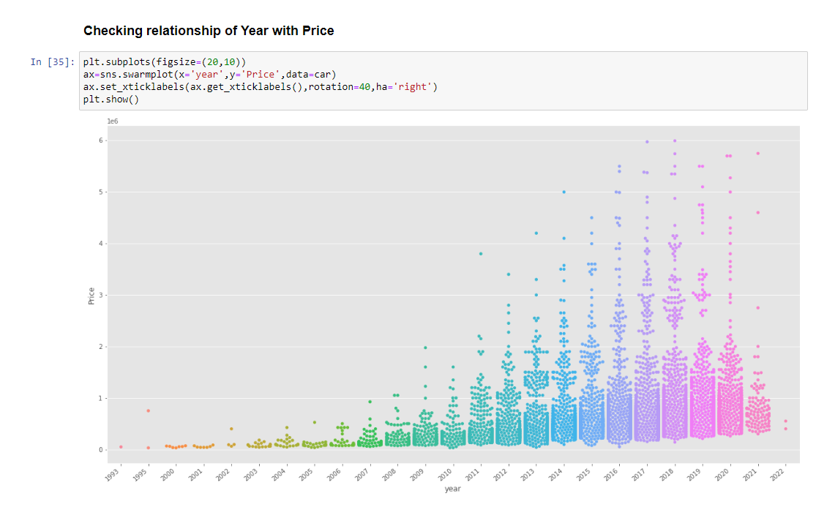

Slide 14
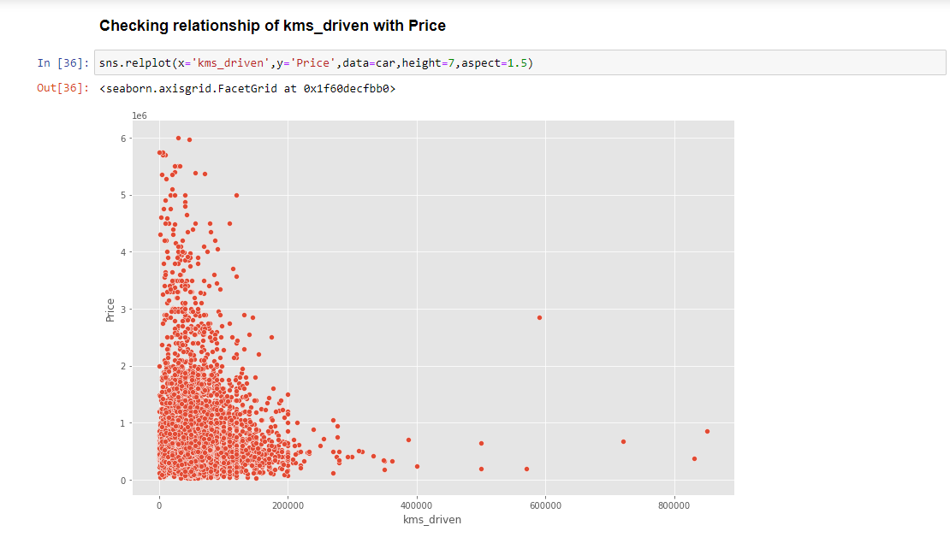

Slide 15
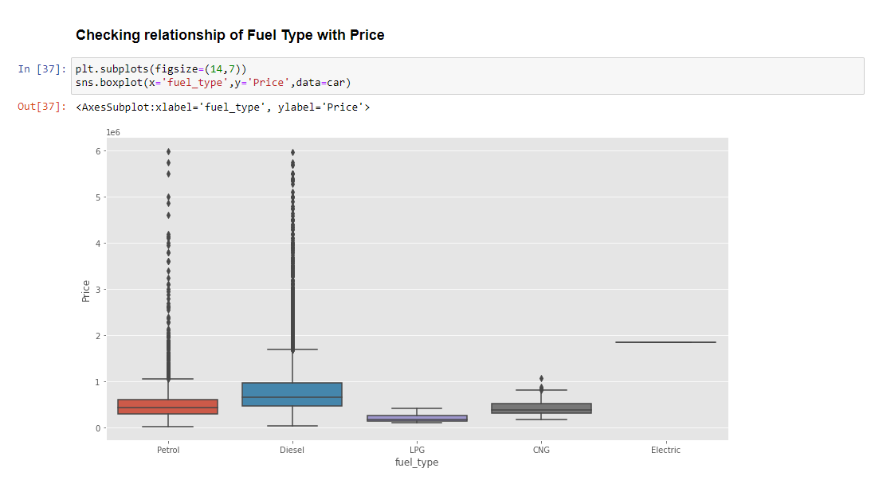

Slide 16
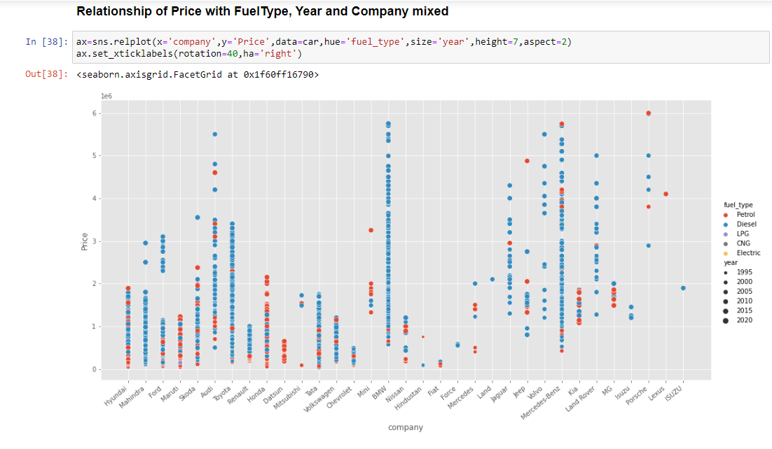

Slide 17
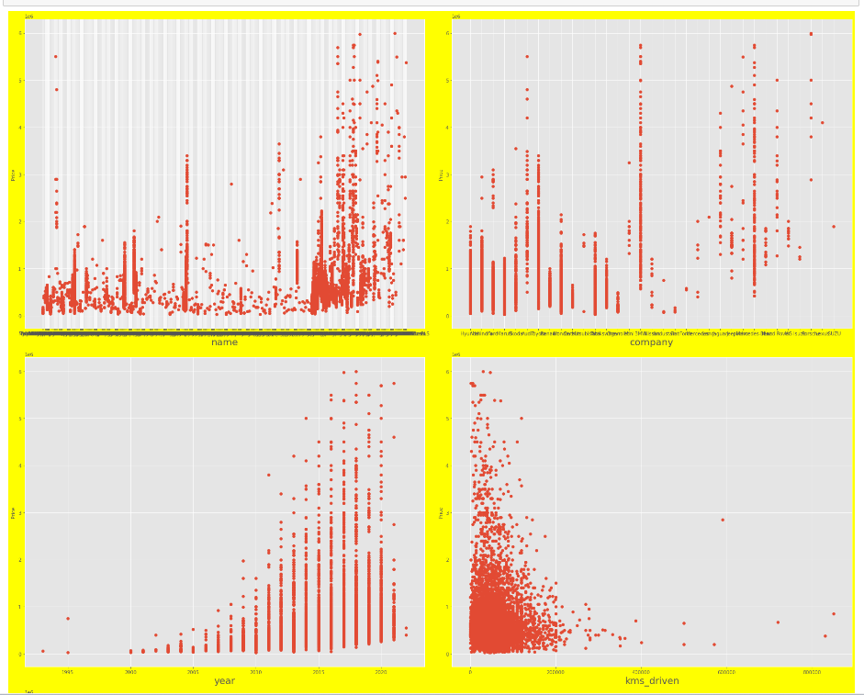
Relationship with Target (Price)

Slide 18
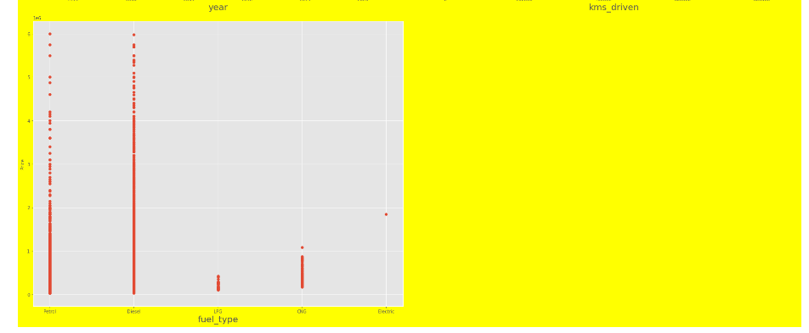

Slide 19
OBSERVATIONS FROM EDA
Studies from the data and the EDA done :
We see that the year is left skewed and the price and kms driven are right skewed meaning the data is fairly new and old year is lesser and there are ouliers in price and kms driven.
Maruthi has the highest number of cars in the dta set almost 80-90%
Most of the cars are petrol and diesel and there are very very few lpg and electric cars
In relationship graph between company and price , we see that benz and bmw cars have the highest range and volvo as well comes in very close
In the same relation graph with year we see that 2016 to 2020 has the highest no of cars
In the kms drive we see that the lower the kms driven the higher the price and the more it has the price decreases which means it has a negative relationship with price
Fuel type as petrol and diesel have the highest more than 95% of data we see the highest range in them ‘

Slide 20
PRE-PROCESSING
Split the features and the target
Used K best to see the best features
Used Variance Inflation factor to see the vif score
After treating the variance did Principal component analysis
Selected the best features and proceeded to model building

Slide 21
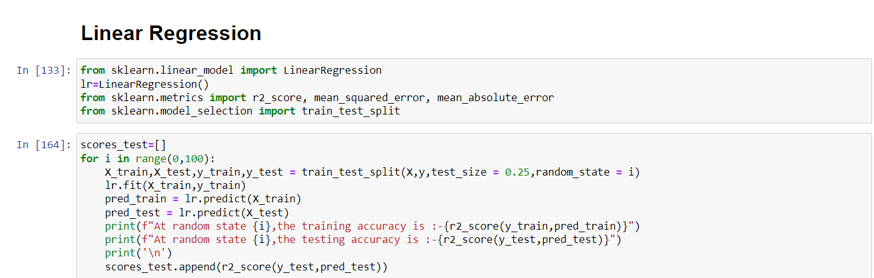
Model Evaluation
Linear Regression

Slide 22
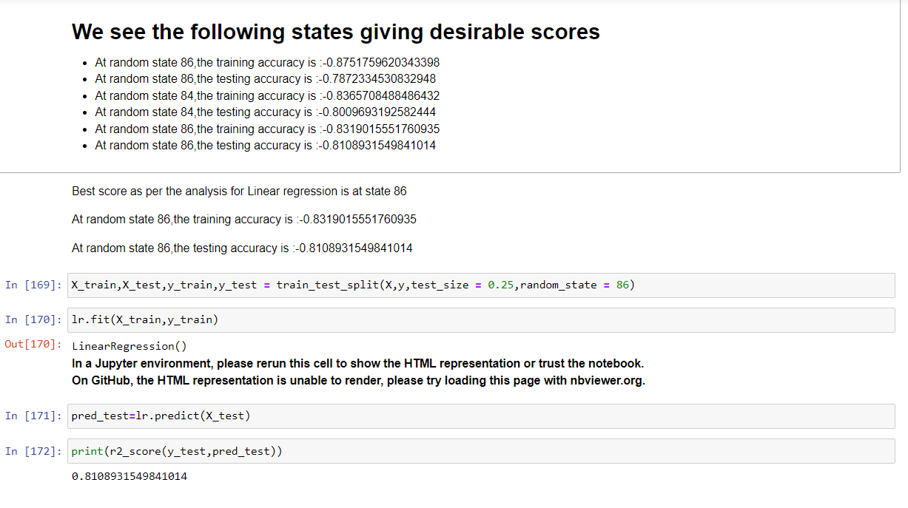

Slide 23
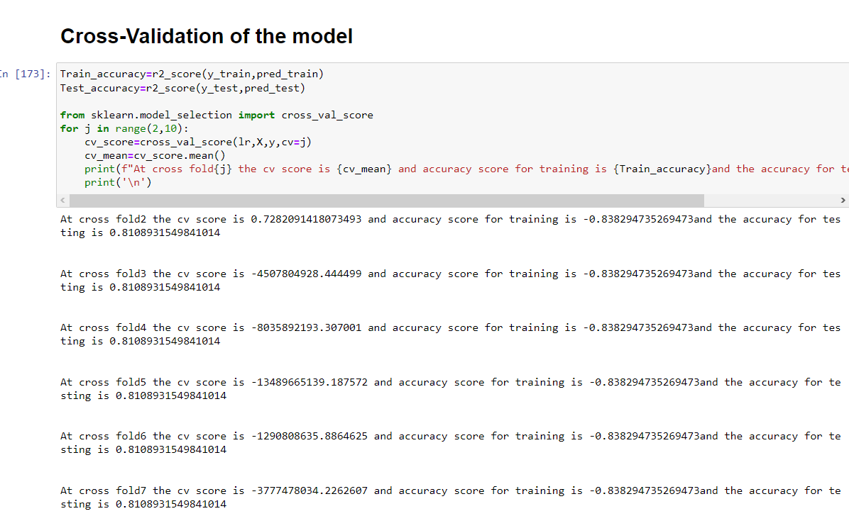

Slide 24
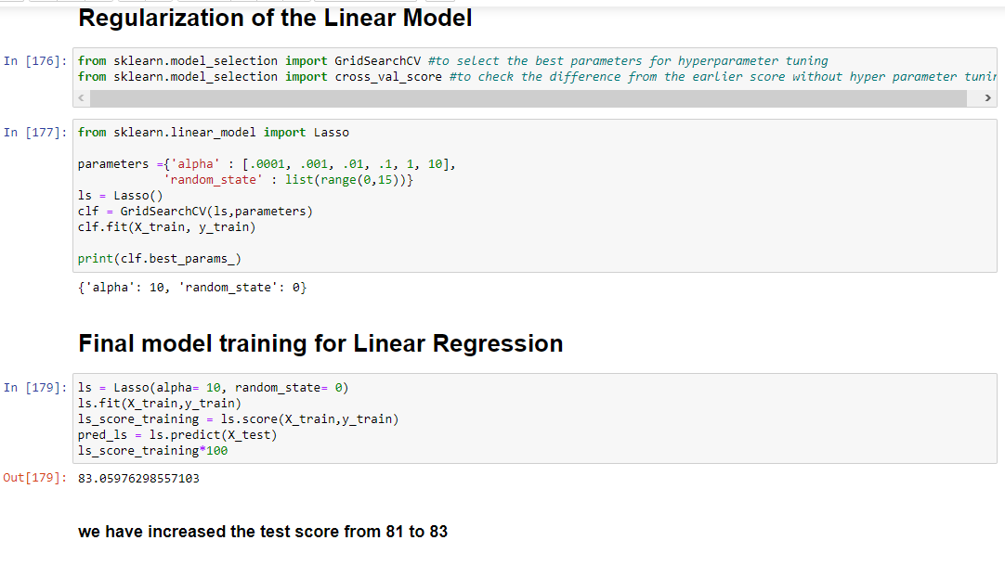

Slide 25
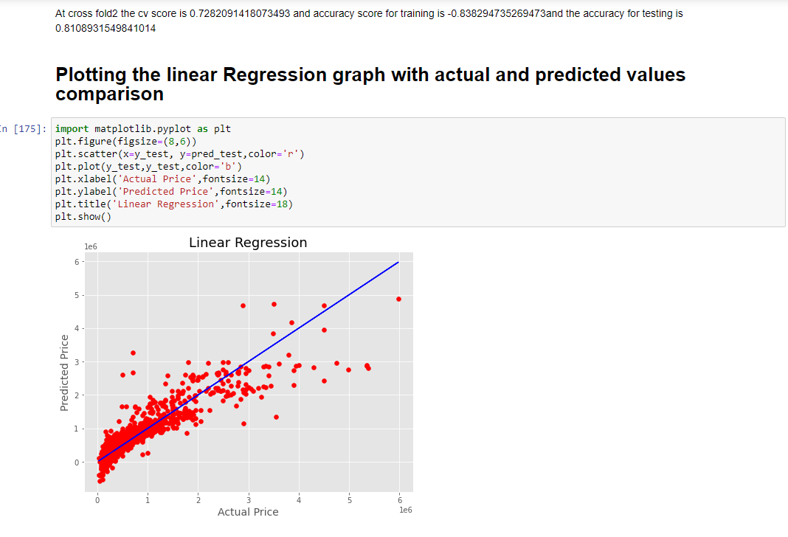

Slide 26
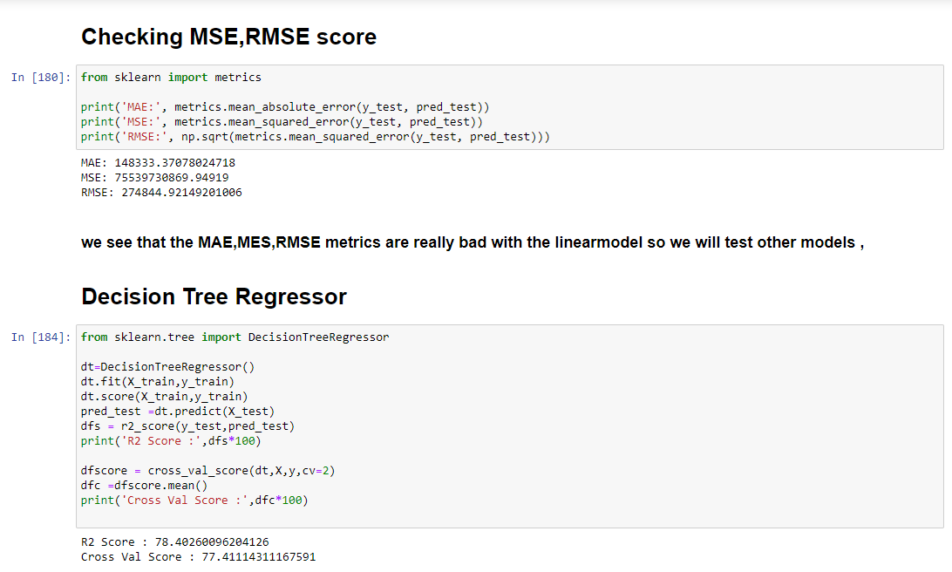

Slide 27
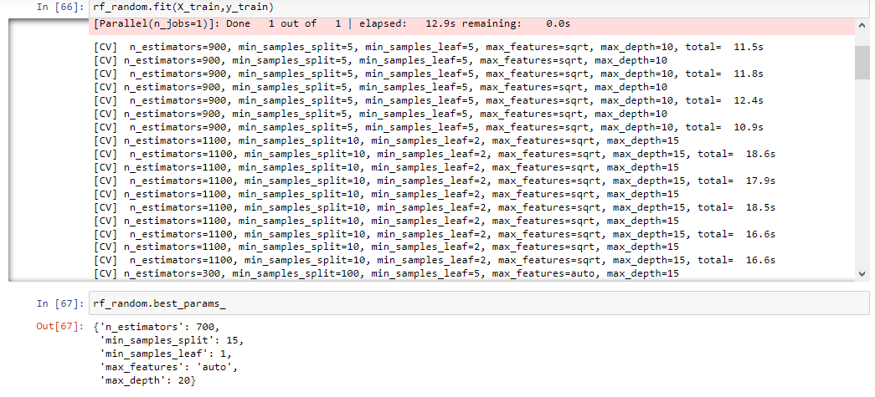

Slide 28
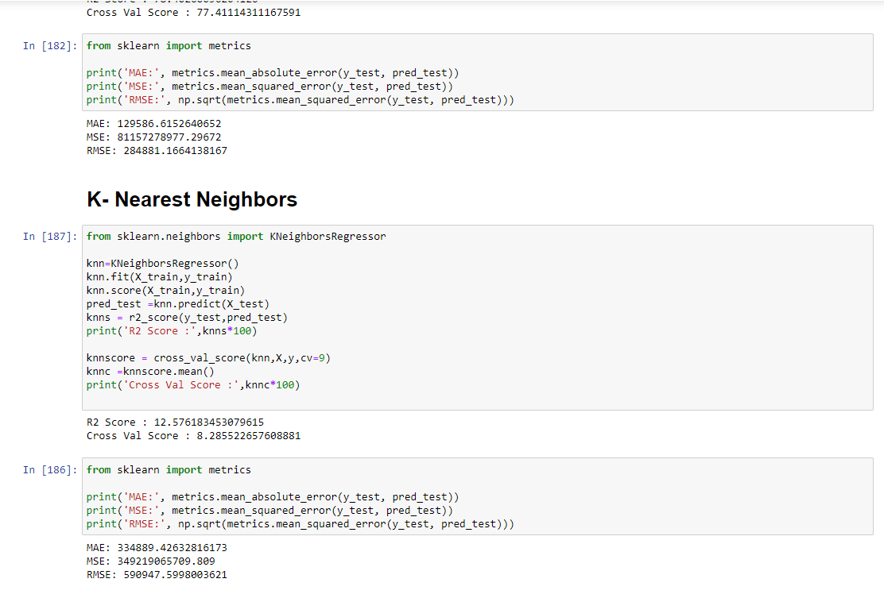

Slide 29
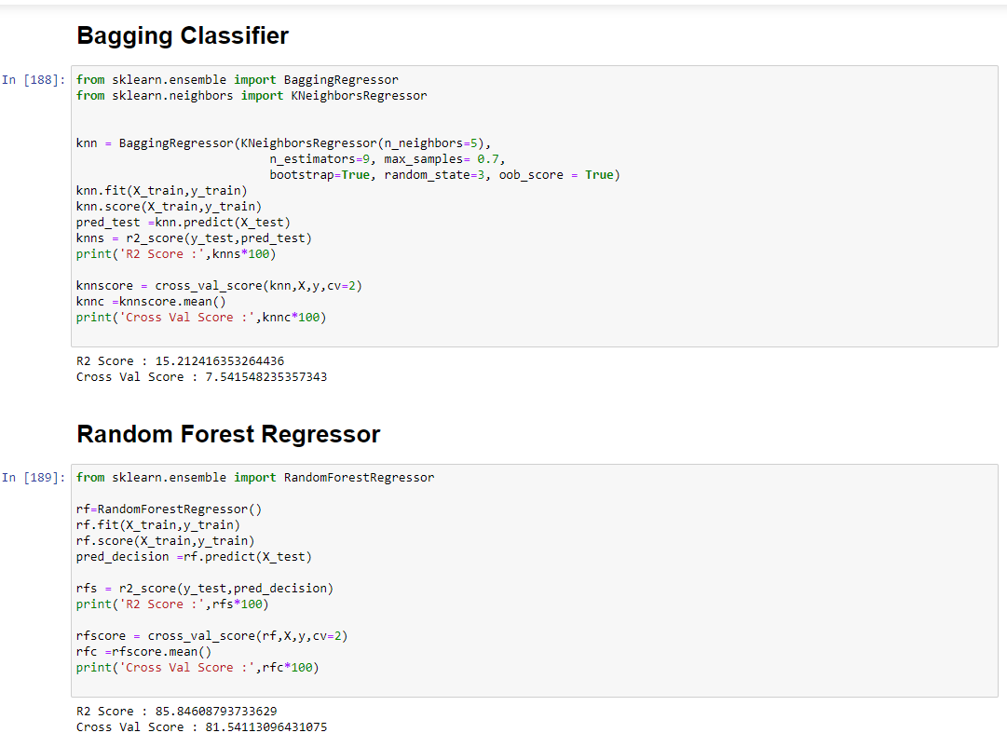

Slide 30
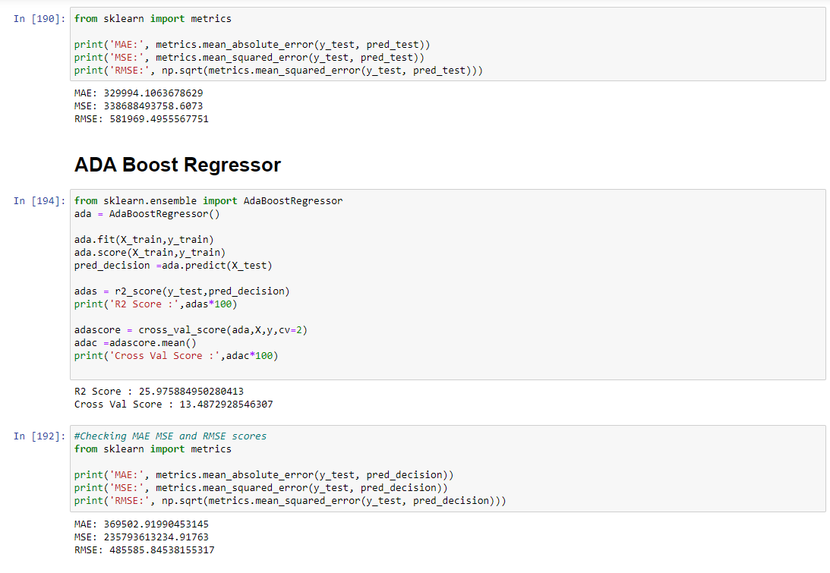

Slide 31
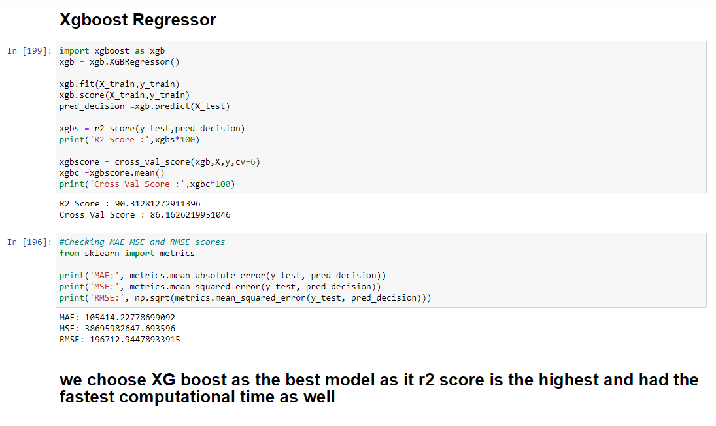

Slide 32
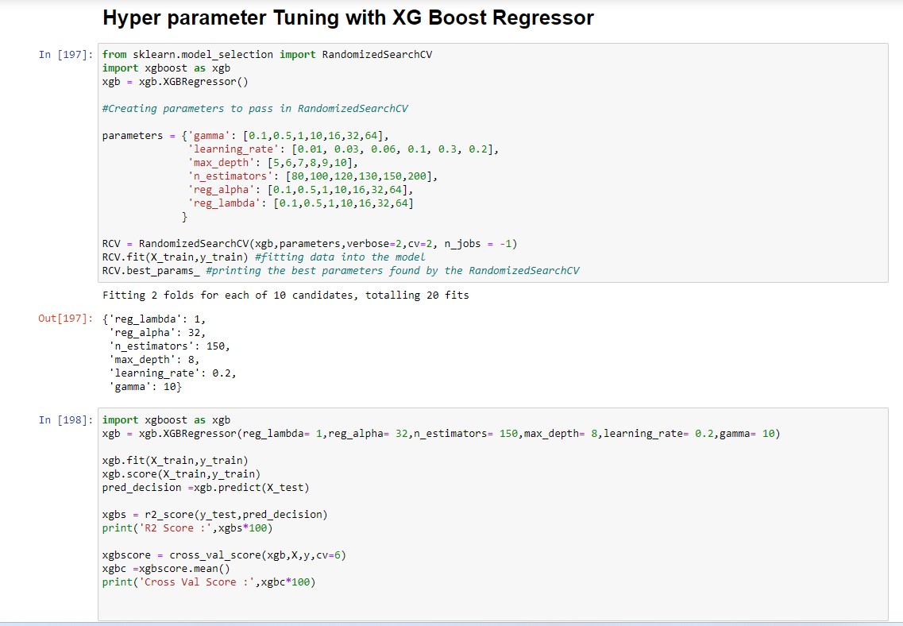

Slide 33
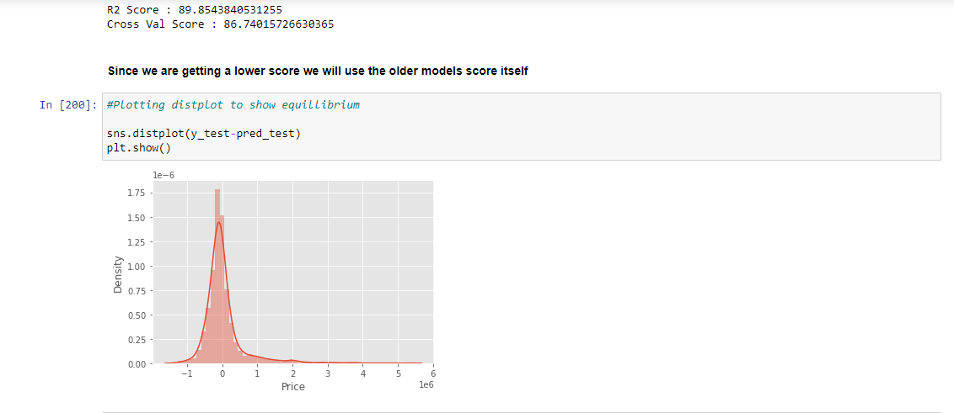

Slide 34
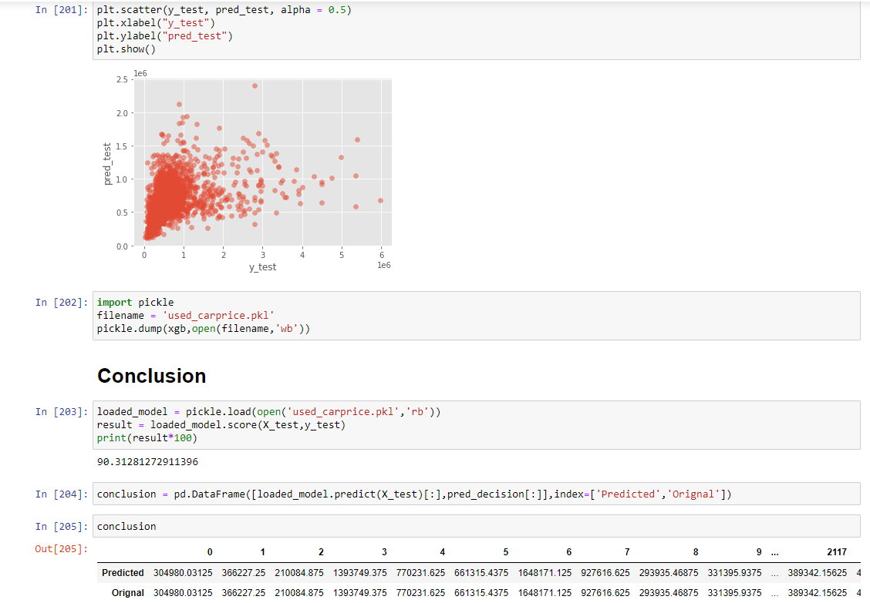

Slide 35
REMARKS
We have many features which have the most influence on the Target and having very impactful features it was really difficult to see prior to model building to come up with a good score or a good model , but since in Machine learning the computation is not statistical alone and the model actually learns the data as a whole , we are able to see such good scores. We see that in most situations we can go with Xgboost regressor as the model is not having overfitting or underfitting , it’s a strong model as well. If we are to use a substitute we can go for Random Forest regression as well as we saw it has a close score to Xgboost but the training was lesser, , But overall has a better and faster processing time so XGBoost regressor is the clear winner

Slide 36
Conclusion
XGoost Regressor gave the best score
Training score for XGB is 90%
Testing score for XGB is 100&
The train is higher than test which random forest didn’t have so we will use this model.

